Slide 1
SAP BTP Extension Suite Training
Day 19
Anubhav Oberoy
www.AnubhavTrainings.com
Follow excellence with sheer passion

Slide 2


DISCLAIMER
The training content and delivery of this presentation is confidential, and cannot be recorded, or copied and distributed to any third party, without the written consent of Anubhav Trainings

Slide 3
Agenda – Day 19
01
Add another UI inside app
02
Working with Authorization
03
Serverless Fiori Apps

Slide 4
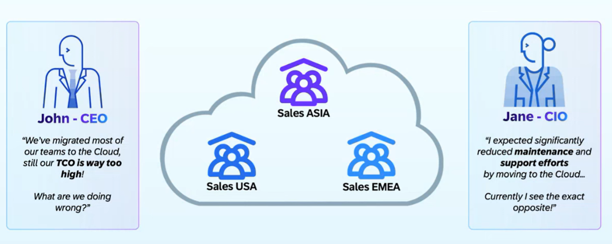
Why Multi-tenant App?

Slide 5
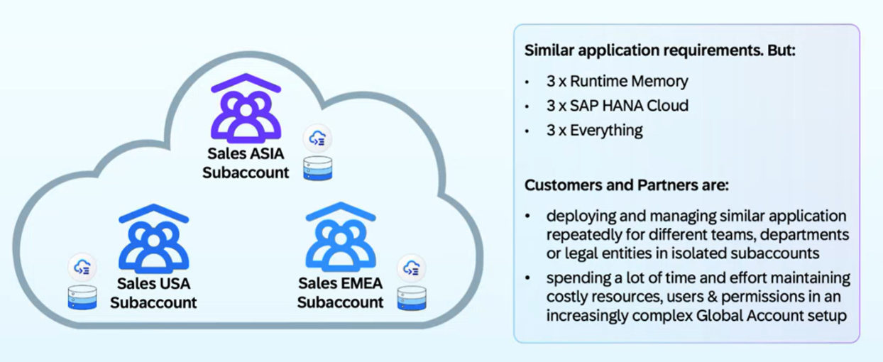
Common Challenges

Slide 6
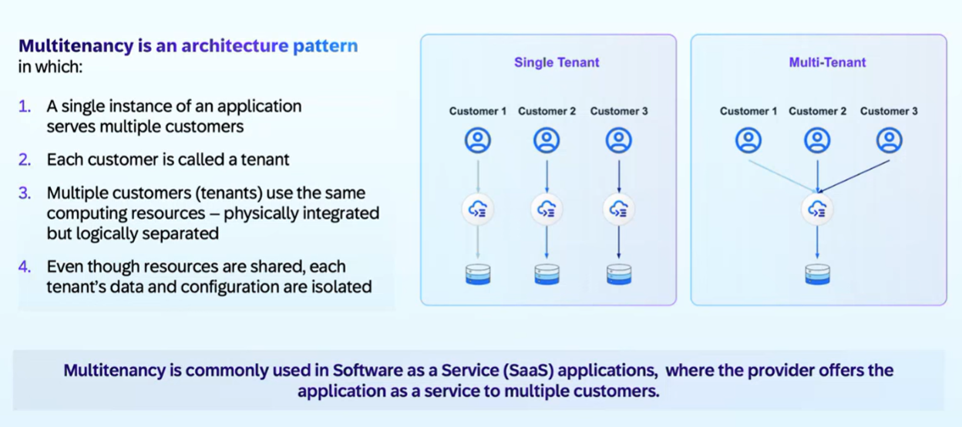
What is Multitenant - SaaS

Slide 7
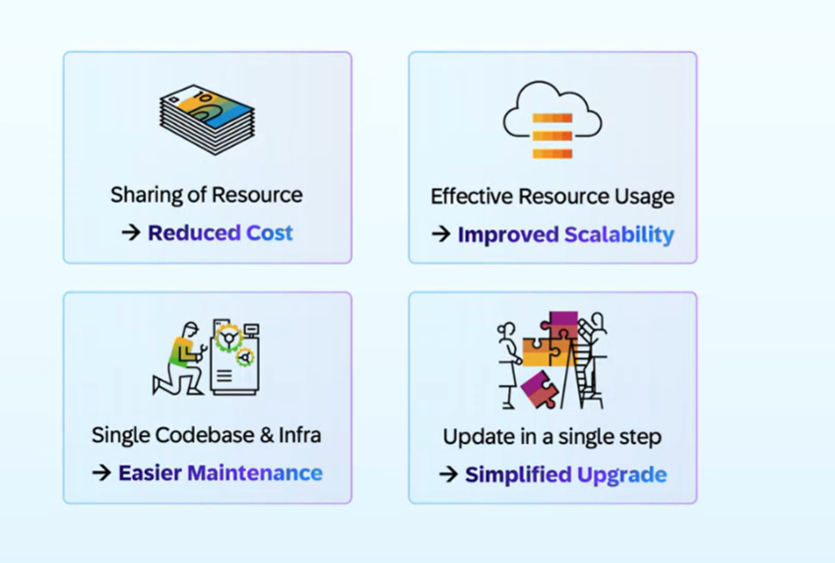
Benefits of Multi tenant App

Slide 8
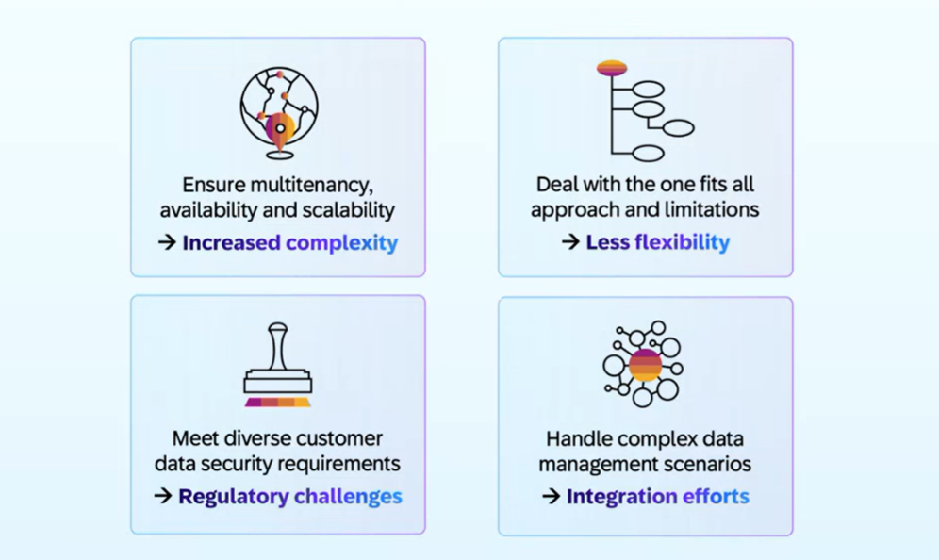
Challenges

Slide 9
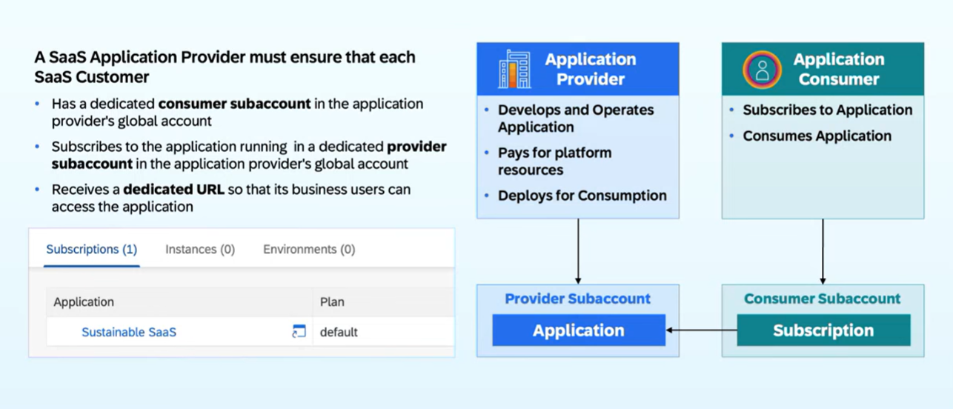
How it works in BTP?

Slide 10






















Slide 11
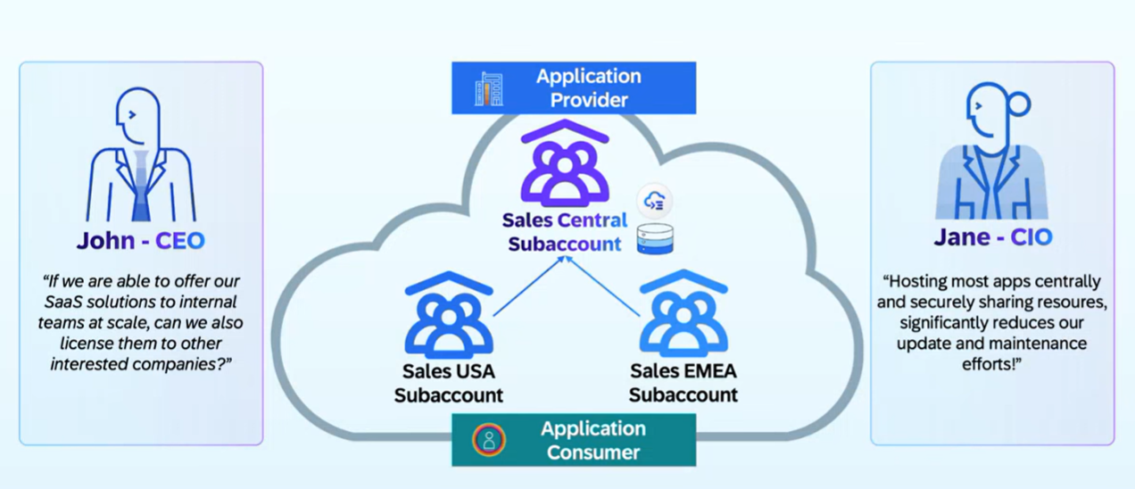
SAP Customer Perspective

Slide 12
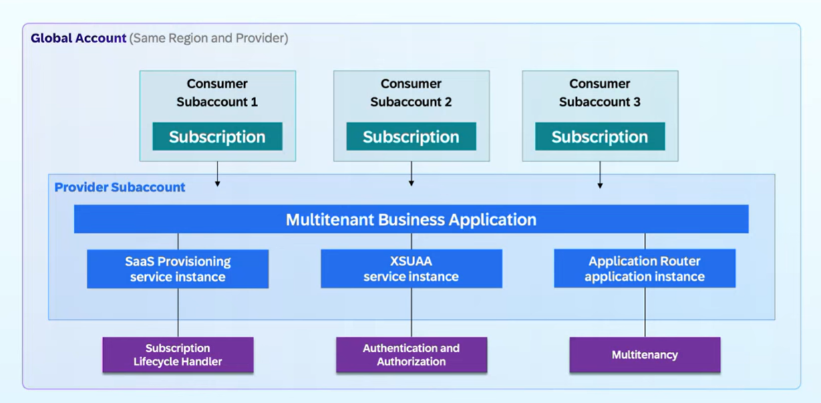
Multi-tenant App on BTP

Slide 13
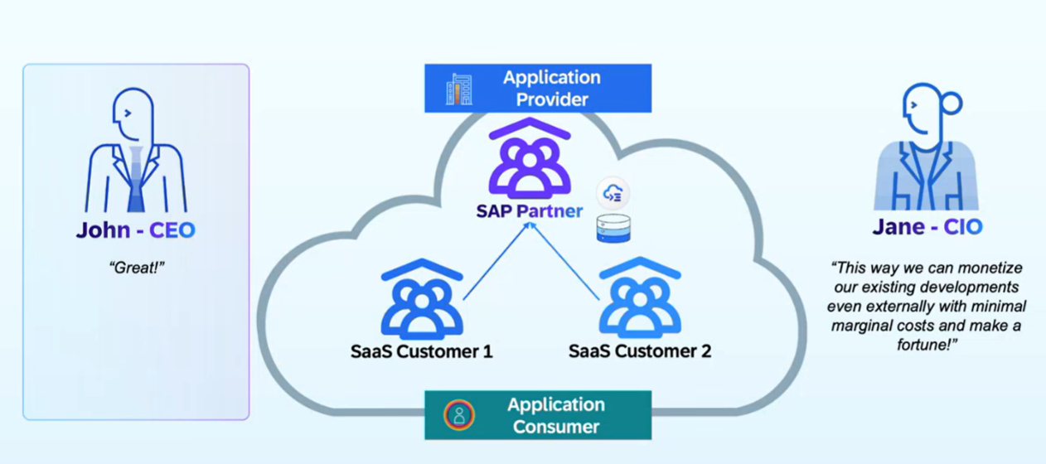
Partner Solutions

Slide 14
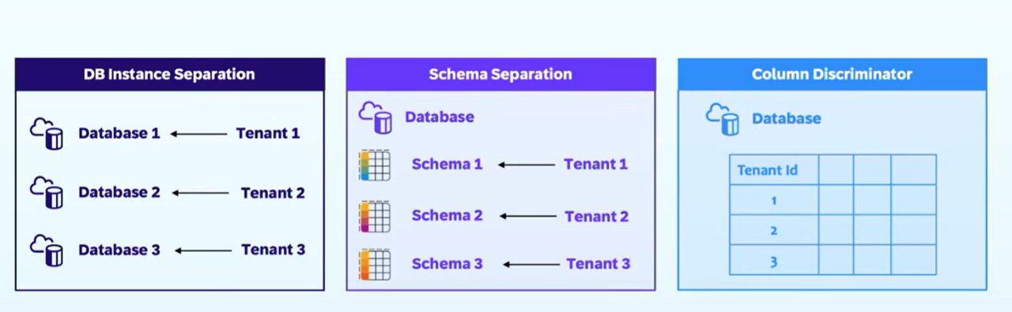
Data Separation for Multi tenant Apps

Slide 15
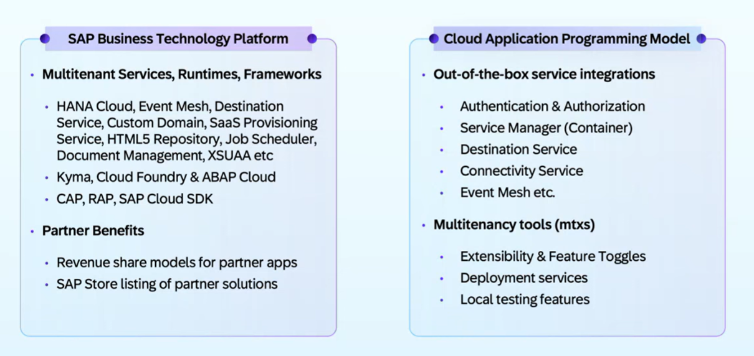
SAP BTP Offerings

Slide 16
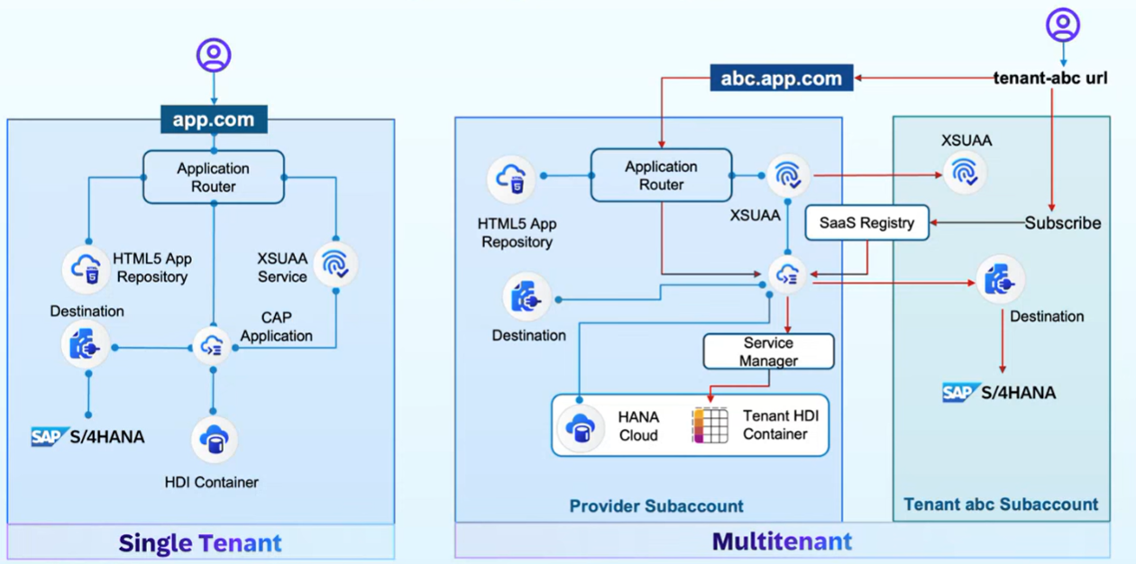
Multi Tenant App – Architecture with CAP

Slide 17
Simple Analogy 1
Think of a restaurant:
- Main Restaurant = Your main CAP application (serves customers/tenants)
- Back Office/Manager's Office = MTX Sidecar (handles tenant registration, upgrades, configuration)
The restaurant needs the back office, but they are separate rooms doing different jobs.
In SAP CAP Context
When you build a multitenant SaaS application, you have:
1. Main Application (Your Business Logic)
- Serves actual business requests
- Handles data from different tenants
- Example: An invoice management app
2. MTX Sidecar (Tenant Management Service)
- Handles tenant onboarding
- Manages database schema upgrades
- Handles extensions
- Example: When a new customer subscribes, this service sets them up

Slide 18
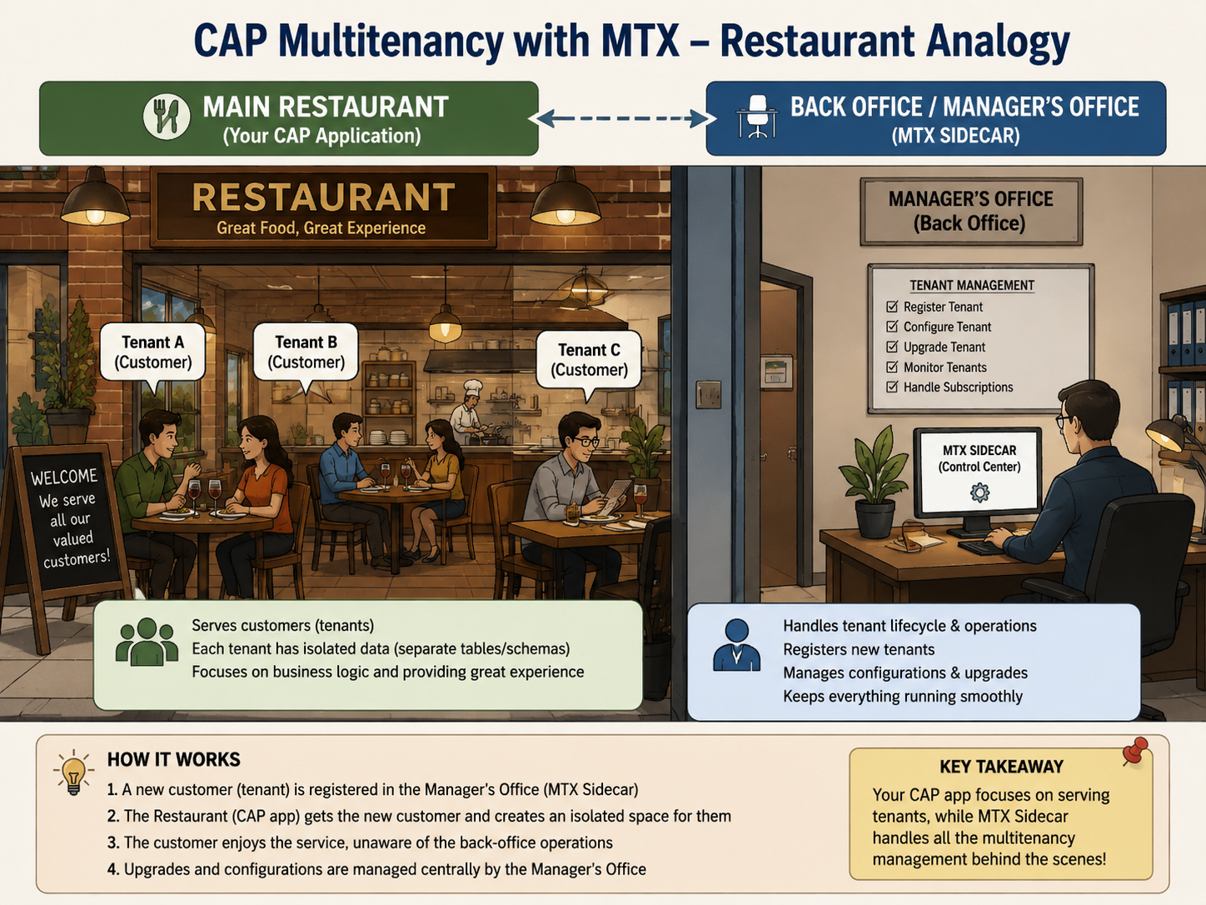

Slide 19
What Happens in Real Life – Customer Side
Scenario: New Customer "Acme Coffee Shop" Subscribes
1. Acme Corp clicks "Subscribe" in BTP
2. MTX Sidecar (`mtx-sidecar` profile) receives the request:
- Creates database schema for Acme Coffee
- Sets up tenant configuration
- Deploys data model
3. Main App (`with-mtx-sidecar` profile) just serves requests:
- When Acme users log in, it serves their invoices
- It doesn't worry about tenant setup - the sidecar already did that
Simple Rule:
- `mtx-sidecar` → Use this for the SERVICE that DOES the tenant management work
- `with-mtx-sidecar` → Use this for your MAIN APP that USES the tenant management service

Slide 20
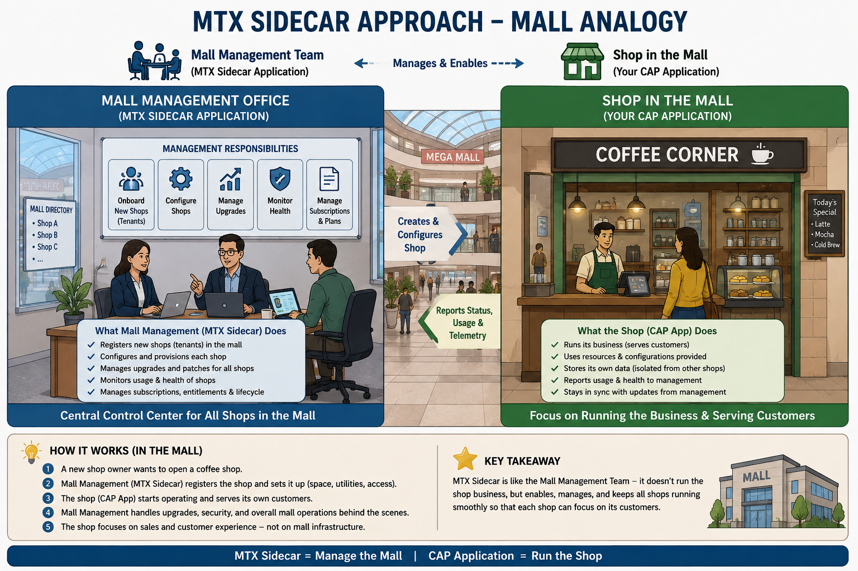

Slide 21
Profiles
In BTP CAP (Cloud Application Programming Model), the difference between `with-mtx-sidecar` and `mtx-sidecar` profiles relates to how the MTX (Multitenancy and Extensibility) services are deployed:
`mtx-sidecar` Profile
This profile is used for the MTX sidecar application itself. It:
- Defines the configuration for the separate microservice that handles multitenancy operations
- Contains the MTX server implementation that manages tenant subscriptions, upgrades, and extensions
- Is applied to the dedicated MTX sidecar service/module in your deployment
Usage: Applied to the MTX sidecar service definition in your `mta.yaml` or deployment configuration.
`with-mtx-sidecar` Profile
This profile is used for the main application service when it's deployed alongside an MTX sidecar. It:
- Configures the main CAP application to work with an external MTX sidecar
- Delegates multitenancy operations to the sidecar instead of handling them internally
- Sets up the proper service bindings and configurations to communicate with the MTX sidecar
- Disables built-in MTX capabilities in the main app since they're handled by the sidecar

Slide 22
Example MTA.yaml
```yaml
modules:
- name: myapp-srv
type: nodejs
parameters:
buildpack: nodejs_buildpack
properties:
CDS_FEATURES_WITH_MTX_SIDECAR: true or use with-mtx-sidecar profile
requires:
- name: myapp-mtx
- name: myapp-mtx
type: nodejs
parameters:
buildpack: nodejs_buildpack
properties:
CDS_FEATURES_MTX_SIDECAR: true or use mtx-sidecar profile
```

Slide 23
Step by Step – Multi tenancy
CAP has built-in support for multitenancy with @sap/cds-mtxs package. Essentially, multitenancy is the ability to serve multiple tenants through single clusters of microservice instance (srv,db,approuter,fioriapp), while strictly isolating the tenant specific data. E.g. you working for tata group and you created one cap app for all group of companies like tata motors, tata tea, tata consultancy service. Tenants are clients using SaaS Solution and subscribing it using BTP consumer account. The application is deployed in provider account.
In contrast to single-tenant mode, applications wait for tenants to subscribe it before they start using it. Simply we can enable multi tenancy in cap applications using cds add multitenancy command. Next we download the module which is added npm install
We check the mta.yaml, system has automatically added a app router for us, however we already have app router with our ui module so we cut the necessary properties like TENANT_HOST_PATTERN, mtx-api, and provides sections and added to our app router, and we removed the auto generated app router. System removes DB deployer, because now the sidecar-mtx application will manage your tenant database (hdi container).
Before deploying to cloud, lets do a test drive common SaaS operations with app locally, including start for MTX app (Mall management to open the mall, clean, allow customers to security scan), start the app (actual Nike shop), we will onboard the tenants (e.g. t1, t2). We enhance mock user strategy with tenant name.
In terminal 1, We will now start the on-boarding side car app cds watch mtx/sidecar → 4005
In terminal 2, We will start the actual multi-tenant app cds watch --with-mtx → 4004
In the third terminal 3, we subscribe app to tenants – cds subscribe t1 --to http://localhost:4005
Subscribe same app for tenant 2 - cds subscribe t2 --to http://localhost:4005

Slide 24
Continue
Change tenant mode in xs-security.json file to shared
After local test was success, we build the project using mbt build
Go inside the mta_archieves folder and cf deploy MTAR_address
We create another subaccount (consumer1) in same data center/provider. Consumer will search our multi tenant app (like sap standard apps sac, s4hana, ds, bdc, sf, bas) and subscribe. Behind the scene a container gets created immediately
The Provider has to add a route of your subdomain in their space.
The consume Admin has to create Role collection and grant permission of multi teant app to their Employees.
Employees gets a link with which they access our app.

Slide 25
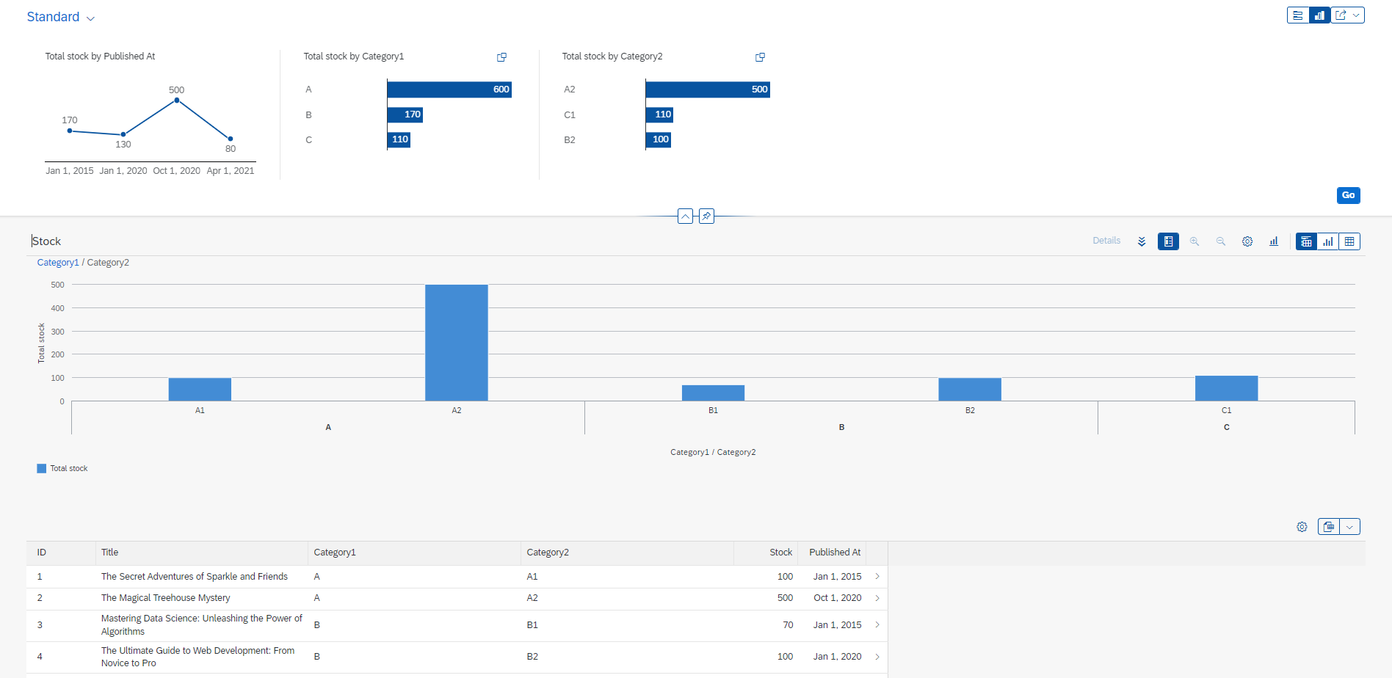
Analytics list page
Text

Slide 27

What We Did
Let’s Summarize

Slide 28

www.anubhavtrainings.com
Thank You
End of Day 6

Slide 29


We’re committed to empower you to be
#FutureReady
through powerful training solutions.
We build the workforce of the future.
260+
Corporate Clients
60,000+
Learners Trained
26000+
Learners Placed
FREE WEBINARS
Sign up for free webinars with industry experts every fortnight!
Enroll Now!
Contact us today!
https://anubhavtrainings.com

